Slide 1
Session II
Web site Deployment
Presented By: Shashi Raina

Slide 2
RECAP
Summary of Session 1
- IaaS
Infrastructure as Code (ARM, JSON)
Notes:
Talking points around now that you have your infrastructure set up using ARM templates…what is the next thing you would do...add roles, applications etc...that is where DSC helps

Slide 3
Desired State Configuration (DSC)
What is it and how to implement it
PowerShell Feature
Managing desired state of resources
Continuous Delivery
Notes:
DSC is state configuration tool similair to Chef, Pupet, It is part of powershell
Deploying and maintaining the desired state of your servers and application resources can be tedious and error prone. With Azure Automation Desired State Configuration (DSC),
you can consistently deploy, reliably monitor, and automatically update the desired state of all your IT resources, at scale from the cloud.
Built on PowerShell DSC, Automation DSC can align machine configuration with a specific state across physical and virtual machines (VMs), using Windows or Linux, and in the cloud or on-premises. You can enable continuous IT services delivery with consistent control and manage rapid change across your heterogeneous hybrid IT environment with ease.
s

Slide 4
Desired State Configuration (DSC)
Push vs Pull
PowerShell : Push (upcoming demo)
Azure Automation : Pull
Notes:
DSC is state configuration tool similair to Chef, Pupet, It is part of powershell
The combination of ARM and DSC is enough to go from zero to a fully configured and ready to use deployment; however triggering and maintaining the deployments is either a manual process, or will require an external orchestration tool. An alternative to this approach is to make use of Azure Automation.
By storing your ARM scripts in Azure Automation you can trigger deployments manually, on a schedule, or allow an external application or process to trigger them using webhooks. Azure Automation could allow you to build a self service way for your users to deploy and tear down their own environments.
Where Azure Automation really comes into its own is the recent update to use DSC and in particular to provide a DSC pull server. A pull server provides an alternative way to get your DSC files to the hosts. Instead of using the ARM script to apply the DSC extension and a particular DSC file to a host, the host registers with the DSC pull server and pulls its configuration from here. By using Azure Automation to act as a pull server you can maintain a centralised repository of DSC scripts which you can easily update and have all of your host pull the changes, rather than updating the scripts on each host. You can also easily see the status of each of your nodes and whether they are in compliance with your desired configuration.

Slide 5
Configuring the Virtual Machines
To add a DSC to existing JSON template
DEMO

Slide 6
Testing the Website
Testing the site via Load Balancer
Test URL from each machine
Use the load balancer URL to access the site
Stop the IIS site on each machine to test the load balancer

Slide 7
About DSC
Things to remember about DSC
Everything is case sensitive
Does not support modular DSC
Support for cross machine DSC dependency
Notes:
You cannot use DSC extension or Script extension both from an ARM template and from powershell. You cannot have multiple DSC or Script extensions per VM, so basically you cannot be modular. This is why I opted not to use DSC extensions from templates, nor scripts, cause I want to keep my doors open in case I need to push a script to a VM once it is created. Even removing and try to set again the extension returns: BadRequest: Multiple extensions per handler not supported for OS type ‘Windows’. Extension ‘Microsoft.Powershell.DSC’ with handler ‘Microsoft.Powershell.DSC’
if you modify a VM to change a vNIC association the old vNIC remains associated.

Slide 8
Wrap up IaaS , DSC
IaaS is great but…
Notes:
Talk about how IaaS is good but it is look of work and takes lot of time. Slowly introduce second option of using IaaS for same website and how easy it can be

Slide 9
PaaS(Website) vs IaaS (using ARM/DSC)
Comparison
Web Deployment : PaaS vs IaaS
Control
Legacy App Support
Management
Agility
Source:Microsoft.com

Slide 10
Web Deployment : What is PaaS
About the platform
Fully Managed Platform
Integrated with Webjobs
Client Side tools
Notes:
Fully managed platform. NO need to worry about mechanics of server.
Integrated with WebJobs. Run in backgroun on same virutal machines.
Various languages. Dynamically scale.
DR options
Dynamically scaling
Geo Replicated site and data
Client side tools:
Visual Studio
-WebMatrix
PowerShell
Xplat-cli (download and install)
Web Browser

Slide 11
Web Deployment : PaaS vs IaaS (using ARM)
When to use PaaS
Use Case for PaaS
Small business
Global Nature
Host Rest API

Slide 12
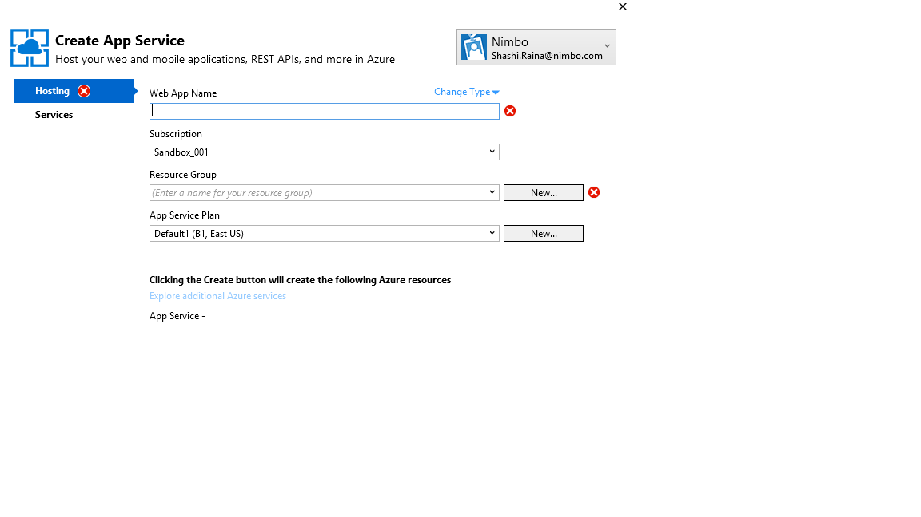
Deploying to PaaS
Demo : Variables to be Configured
W We
WebApp Name : paasbootcamp+[latename+first initial]
ResourceGroup : paasrg+[latename+first initial]
AppServicePlan:paasplan+[latename+first initial]

Slide 13
Deploying to PaaS
Demo : Deploying sample website to PaaS using Visual Studio
DEMO

Slide 14
Thank You

